Slide 1



google app store data analysis
DETAILED PROJECT REPORT
Sham Ambadas Johari

Slide 2


CONTENTS
Problem Statement
Objective
Introduction
Architecture
Insights
Conclusions

Slide 3

PROBLEM STATEMENT
Android is expanding as an operating system. It has captured around 74% of the total market which is a true indicator of the huge amount of population using android. Our goal is to help android developers to know what is the motivating factor for people to download an app. It will also help to find out the factors that affect someone’s decision to download an app. I would like to analyse category, reviews, price, ratings and installs for this purpose and find out how they are inter related.

Slide 4

OBJECTIVE
The aim of my analysis is to provide insights about android applications and their categories.I want to deep dive in data for the factors of influences on an application, to know why and how certain applications succeed and others. Also, what is required for an application to be considered as successfully topping the charts.

Slide 5
Introduction
Android is the dominant mobile operating system today with about 85% of all mobile devices running Google’s OS. The Google Play Store is the largest and most popular Android app store.
The purpose of our project was to gather and analyze detailed information on apps in the Google Play Store in order to provide insights on app features and the current state of the Android app market.
We collected descriptive information on over 3,100 apps across 11 different categories in the Google App Store. We focused on the following 11 categories: Business, Food & Drink, Books & Reference, Travel & Local, Health & Fitness, News & Magazines, Education, Social, Finance, Medical, and Entertainment.
Each app has its own web page where detailed information about the app is available. We used Selenium to scrape information about each of these apps for our analysis. We scraped app title, category, developer name, whether an app contains ads, rating, number of reviews, app size, number of installs, and price.

Slide 6




ARCHITECTURE
Dataset
Importing
Libraries
Read Dataset
Missing value
Imputation
Report
Exploratory Data Analysis
Handling Outliers
Data
Cleaning
Data visualization
By using EDA.
Documentation for several graphs.

Slide 7
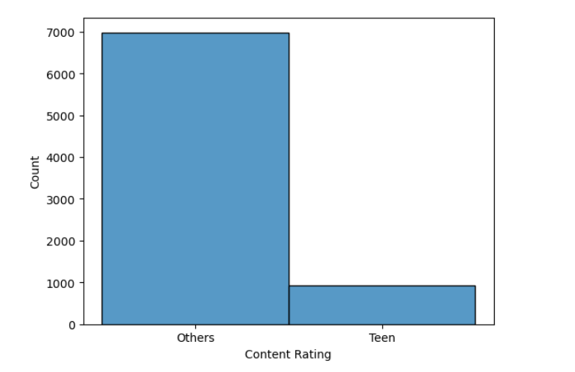
INSIGHTS FROM ANALYSIS

Slide 8
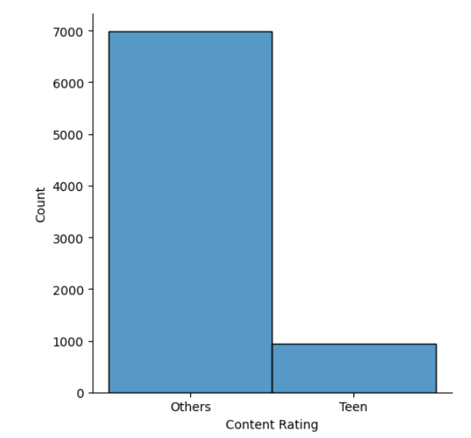
Contend rating others vs teen

Slide 9
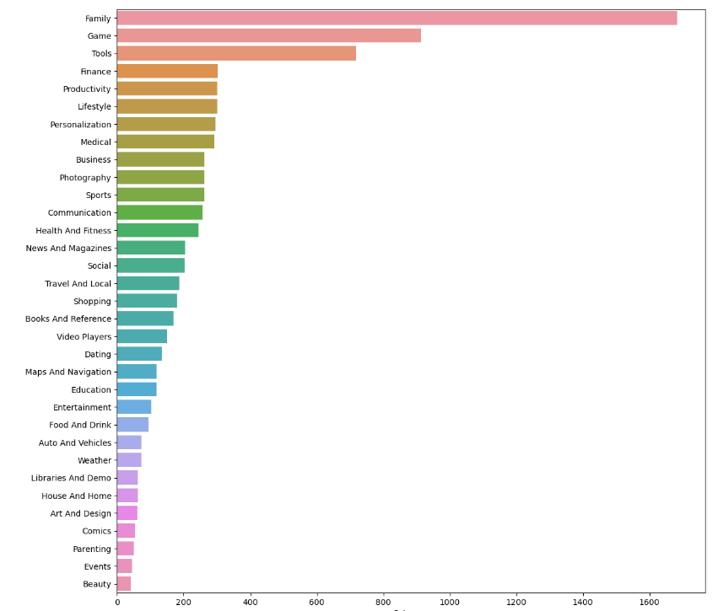
check famous category

Slide 10
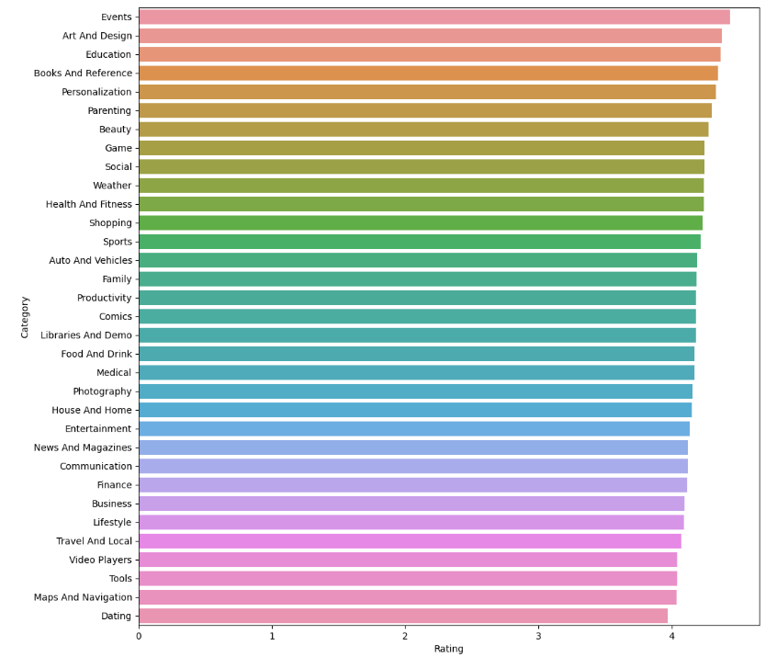
Categorical rating

Slide 11
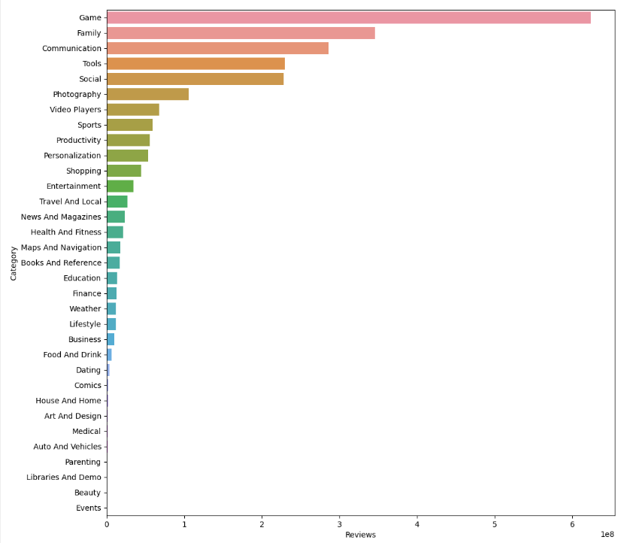
Categorical Revenue

Slide 12
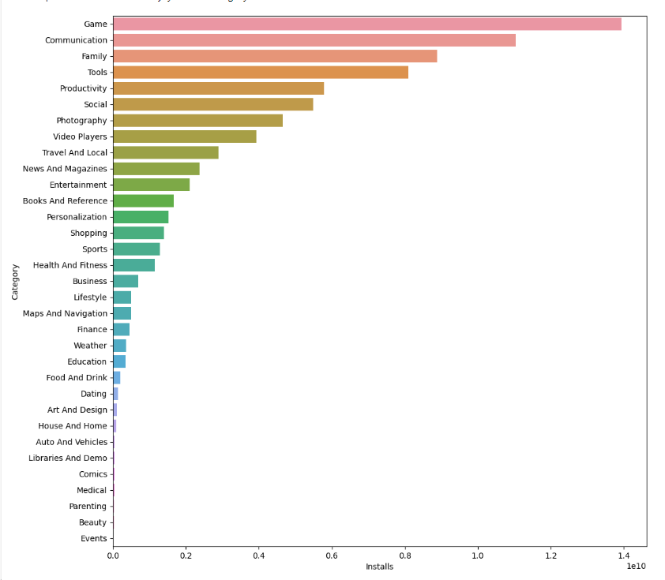
Categorical installation.

Slide 13
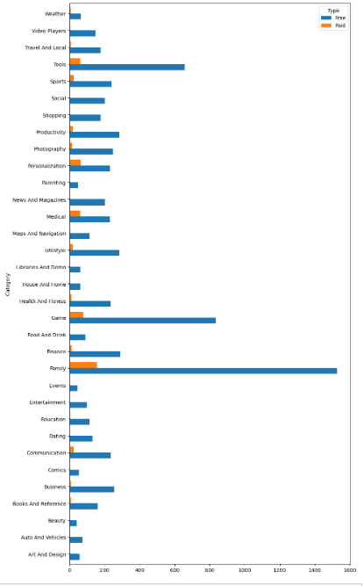
Category call type free versus paid

Slide 14
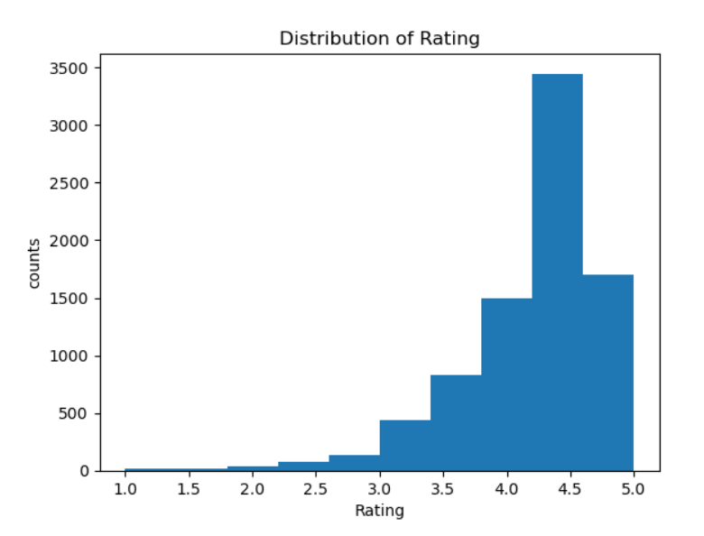

Slide 15
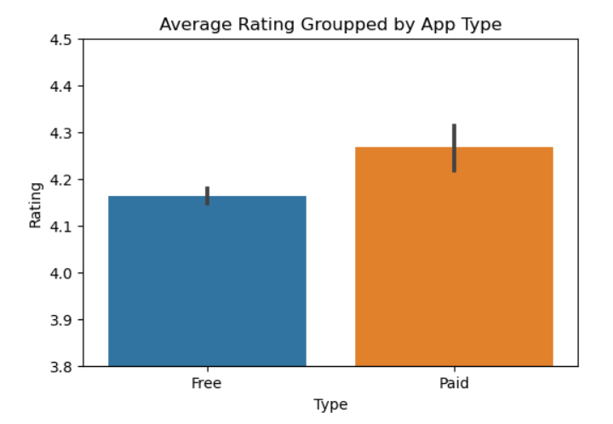

Slide 16
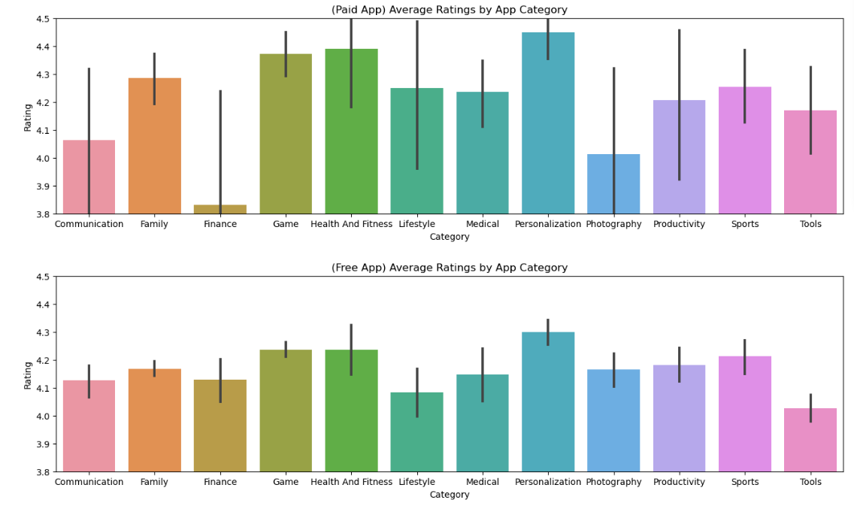

Slide 17
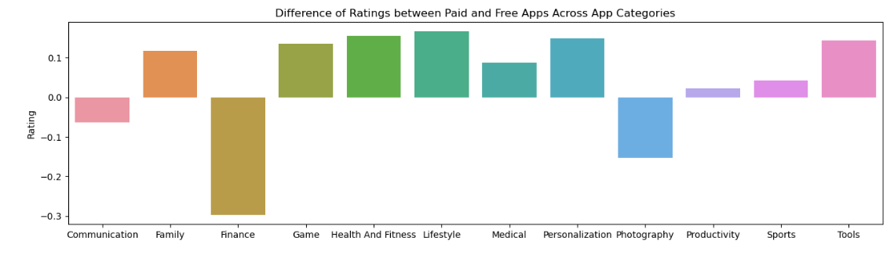

Slide 18
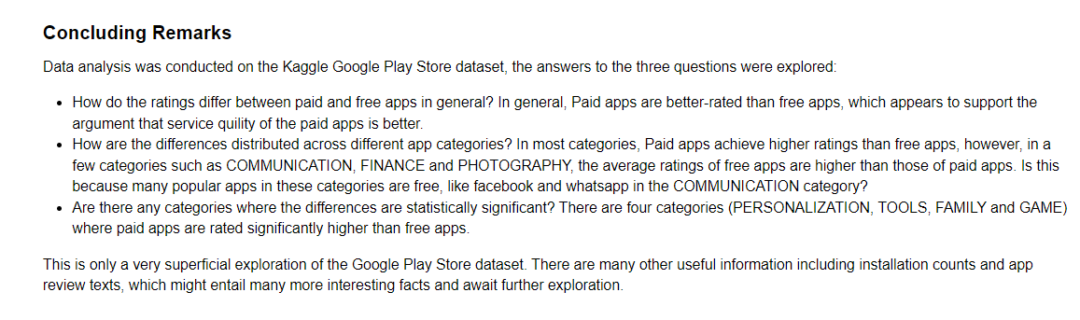

Slide 19
Thank You!!!

